Slide 1
THE GRAVE ADVENTURES OF BUMBUH JONES HD RETRO EDITION
Game Pitch
Ryan Chapman

Slide 2
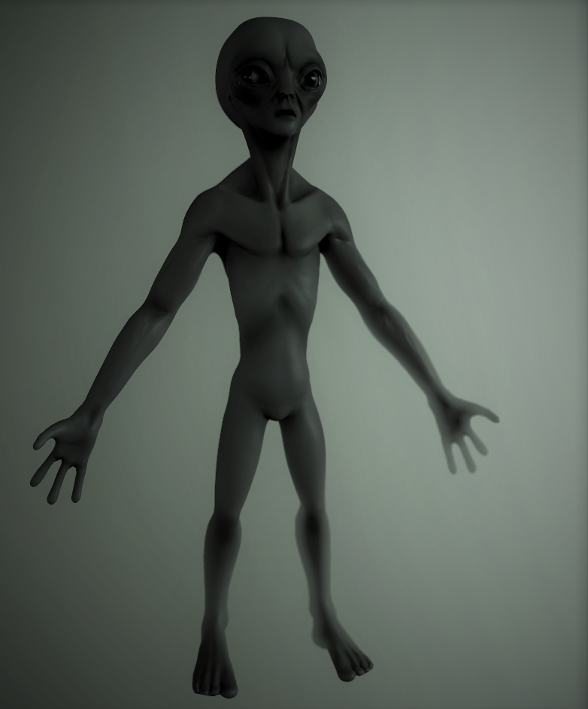
What is this?
Bumbuh Jones is probably one of the best IPs we worked on and the most successful in terms of development
However, there are several factors that lead to it’s untimely demise:
Graphical Fidelity
Menus
Complicated (and numerous) character art
Desired unreachable quality
Inability to scale down graphics causing chugging on several (2) playtester’s PCs

Slide 3
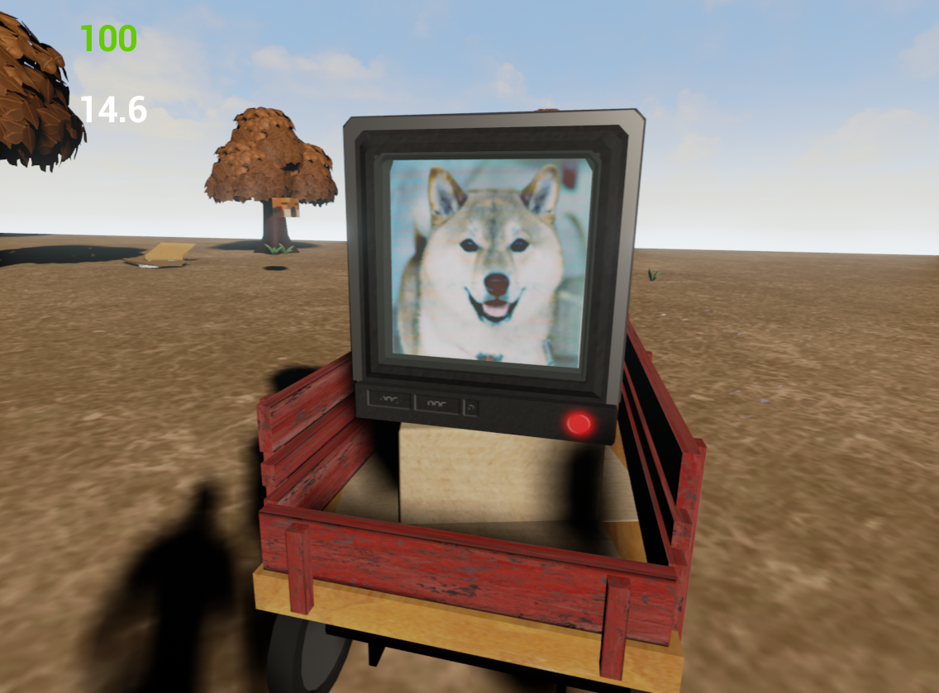
Literally WHAT
Basically, Bumbuh is good and we shouldn’t get rid of it
Here’s a list of what we did right:
Modular rigging/animations for multiple characters saves time and effort
Modular assets (houses) with drag and drop textures
Recorded a shitton of audio
Have locations, story, and characters all designed and written down

Slide 4
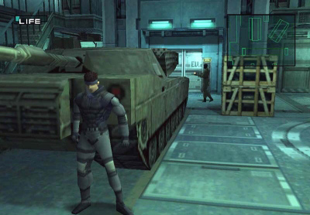
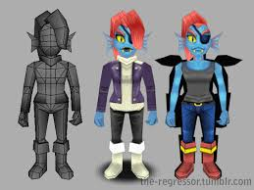
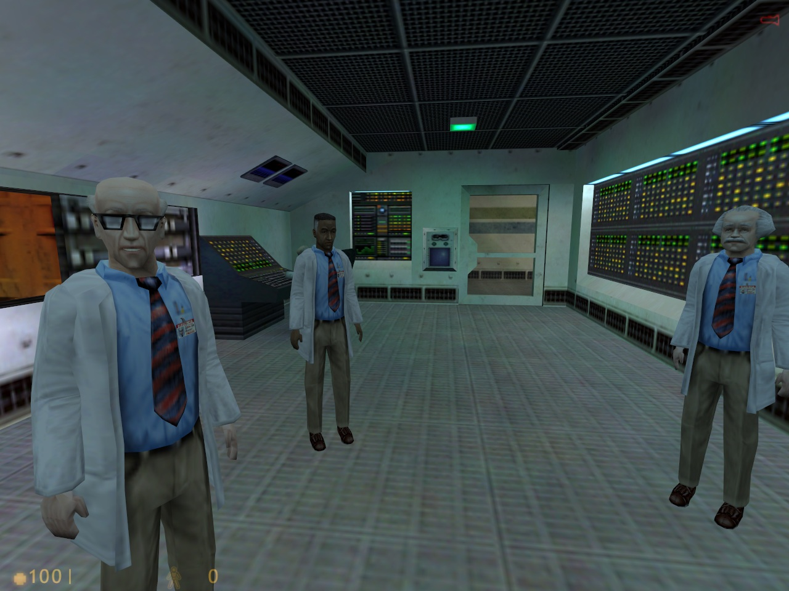
ON WITH THE IDEA ALREADY
Use what we already have; literally same animations and everything, maps, etc.
Reduce texture sizes drastically
Reduce character and some environment poly-limits drastically (make new characters NOT sculpted)

Slide 5
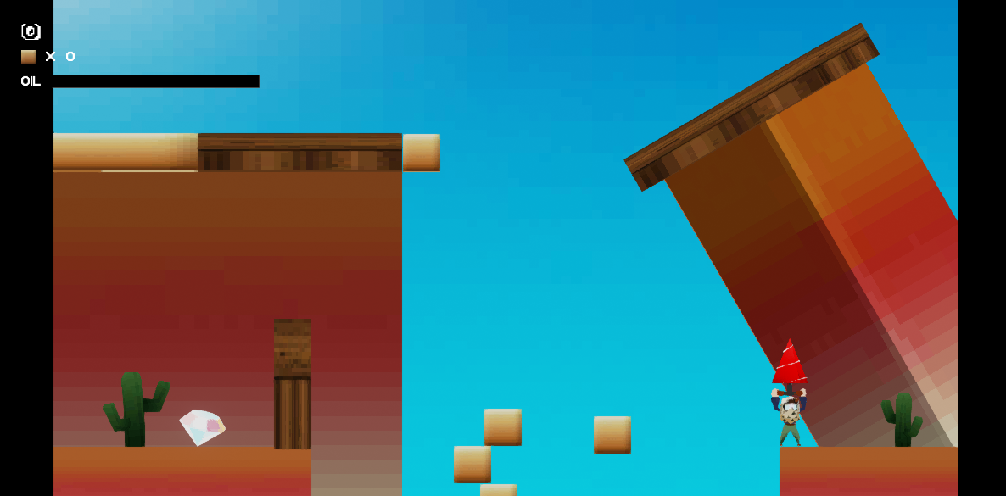
Ryan, are you scamming me. I’m not falling for this again
Of course I am scamming you
But seriously. Raining Donkeys is proof that this can be done.
Character took ~6 hours to model, texture, rig, and animate. The assets are simple shapes except the donkeys (which admittedly look like trash but the snakes are cool)
The retro 3d art style is making a comeback due to 90s nostalgia being in higher demand than the previous arcade 80s nostalgia
This can work

Slide 6
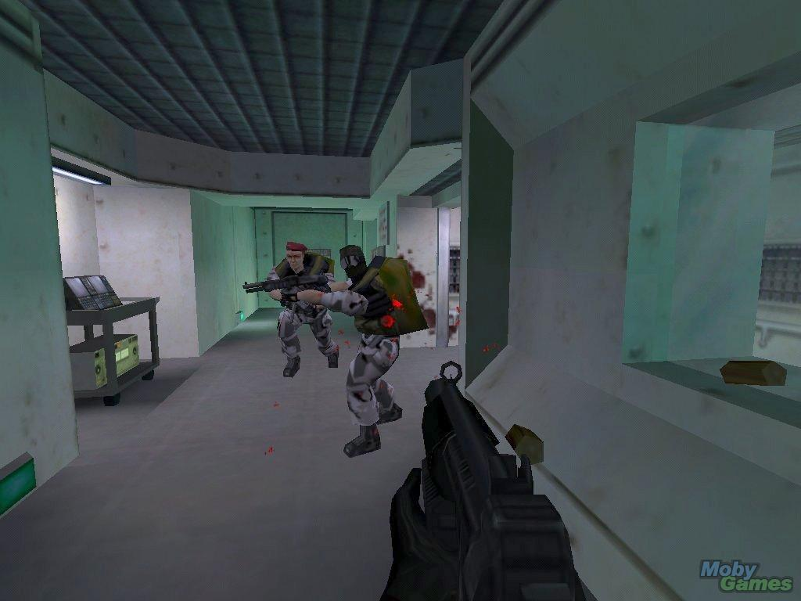
Ok so how can we make it not trash
We need to find a good balance between low poly and low res
We want our game to look good, but also inhibited in a way, but not trash
The game almost requires a retro feel to it to retain it’s charming quirkiness.
Watch the following video for example

Slide 7

Hilarious video that used to be serious

Slide 8
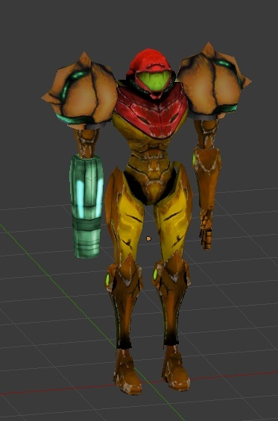
Advantages of low poly
There’s a lot of perks for doing this. It eliminates the need for mouth movement, but can be animated in a way that’s funny and lends itself well to the story.
If Bumbuh (the game) takes itself seriously-ish yet has this quirky retro art it could add to the charm of this otherwise weird and forgettable game

Slide 9
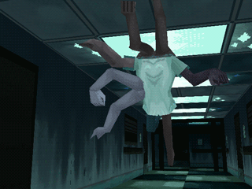
Advantages of low poly
You can recycle character models inoffensively
It wont be jarring because it will be lower res
Act like you’re on a budget and people will accept it as such
Try too hard, fail, and be harshly criticized and largely ignored
Bumbuh is all about not giving a shit, and that was our original mantra until we gave a shit. The original idea was muddy to me but this seems clear now

Slide 10
We need to act like a 3 man team
Not only are we a 3 man team but this is also not what we do all day long. We have other responsibilities. We need to examine our scope and abilities
I’d really like your help and I think you could feel a lot of pride in the final game, despite it being low poly
Remember KEVIN Low poly =/= looks bad. We do need to work on visual appeal but the process will be easier due to our current limitations

Slide 11
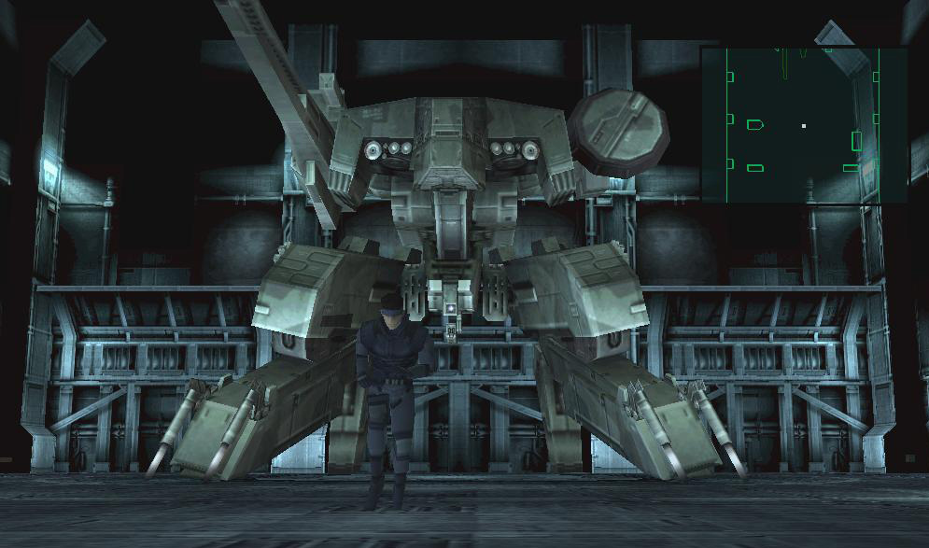
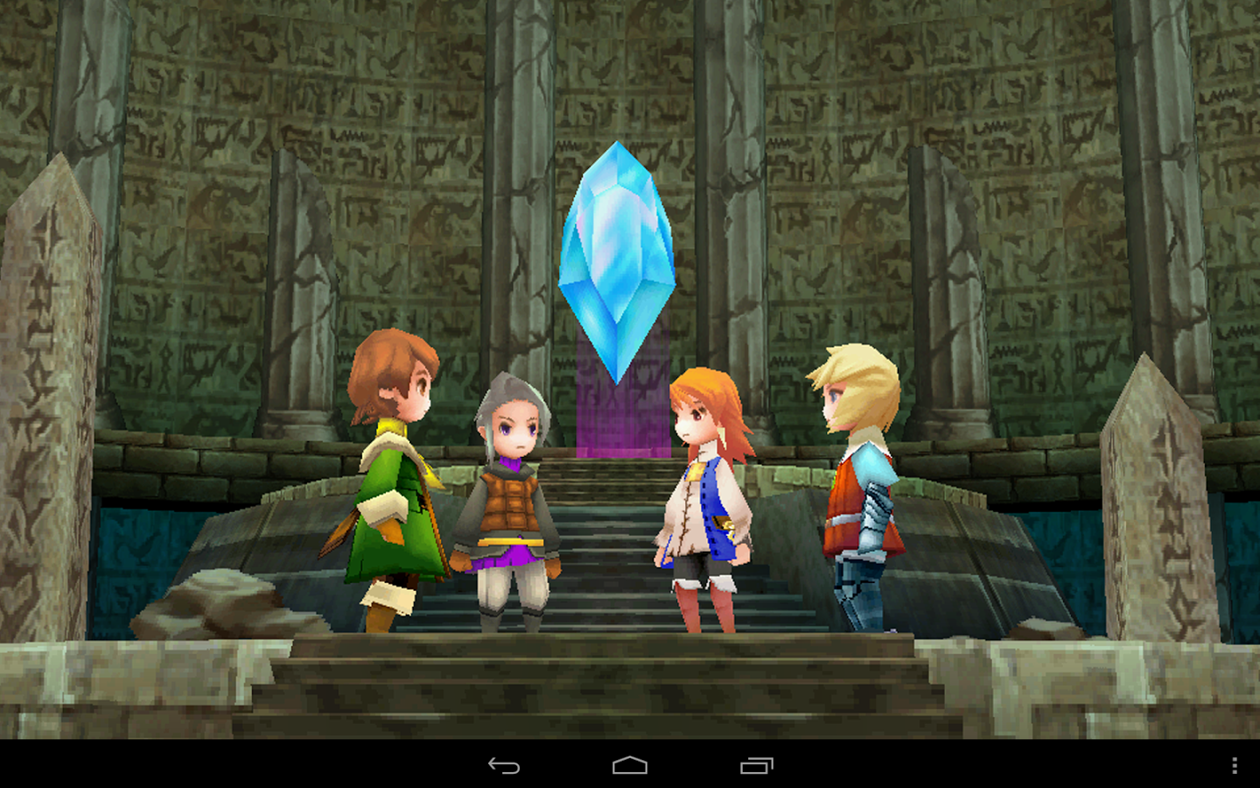
Game Limits
Environment assets do not exceed 500 tris unless absolutely necessary.
Characters do not exceed 1.5k tris unless absolutely necessary
Texture sizes do not exceed 256x256. However, we can also have 512x512 sheets with multiple assets mapped to them, as long as the pixel density is consistent.
Little to no alphas
Animation remains consistent quality, but talking will need extra (and hilarious) head movements
This does not count for random NPC talking like Skellingtons

Slide 12
Well we always get stuck and give up on programming
All I need is a save function and that’s it. We will not have menus for graphics options or anything. Just save, quit, load.
Punching, damage, jumping, running, dying, respawing is ALREADY implemented, remember? I got it working with the fish mechanic.
The game is already basically programmed. We just need to spend some time paring it down graphically and wrapping up key areas like the Farm before moving onto new areas like EPC and Nevado.

Slide 13
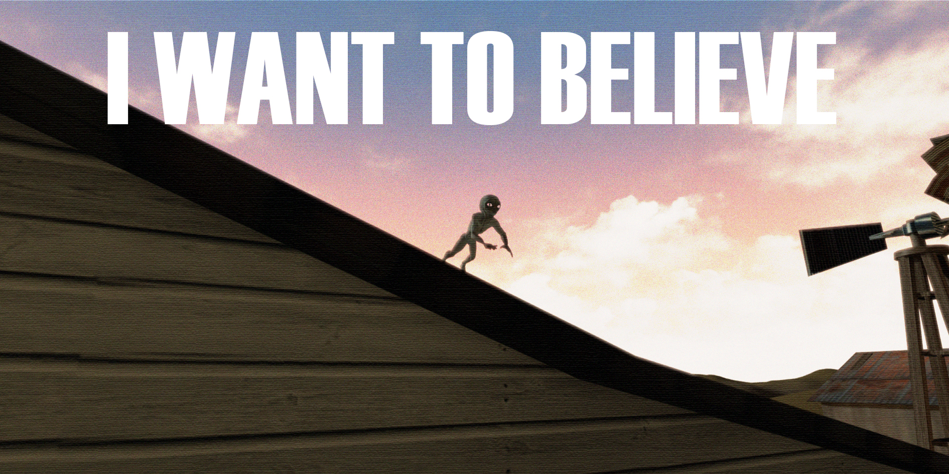
Will you do this?

